Slide 1

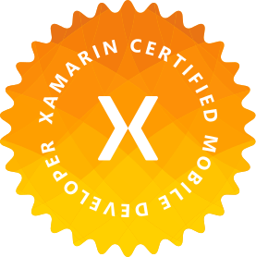
Azure AD B2C
Sam Nanduri
Sr. Mobile Developer Southeastern Grocers
@xamarin007
sam@xamarin007.com

Slide 2
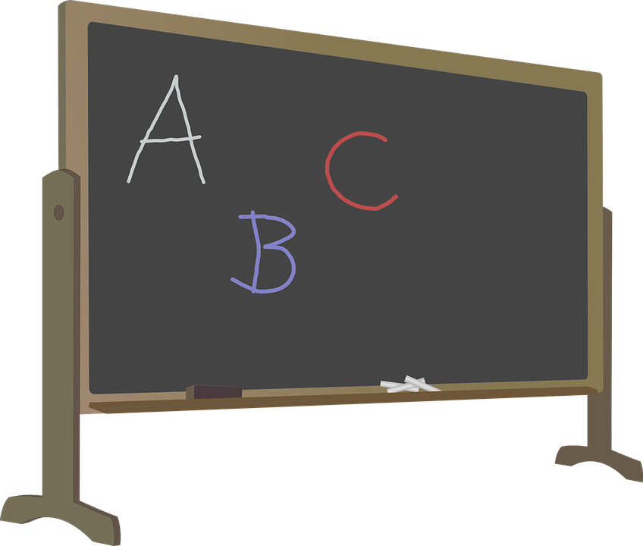
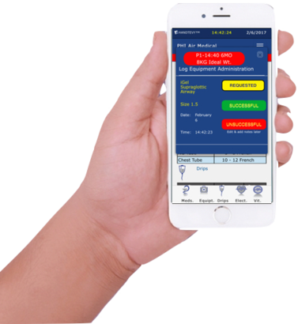
Agenda
Fundamentals
Demo

Slide 3
What is Azure AD B2C ?
It’s a Cloud Identity Service
Built on Azure Active Directory
Highly secure and handles billions of authentications per day
Reach any user on any platform ( Android, iOS or web)
Allow users to sign in with existing social accounts or personal emails. Azure B2C supports Twitter, Facebook, Microsoft Accounts, Google+, LinkedIn and many others …

Slide 4
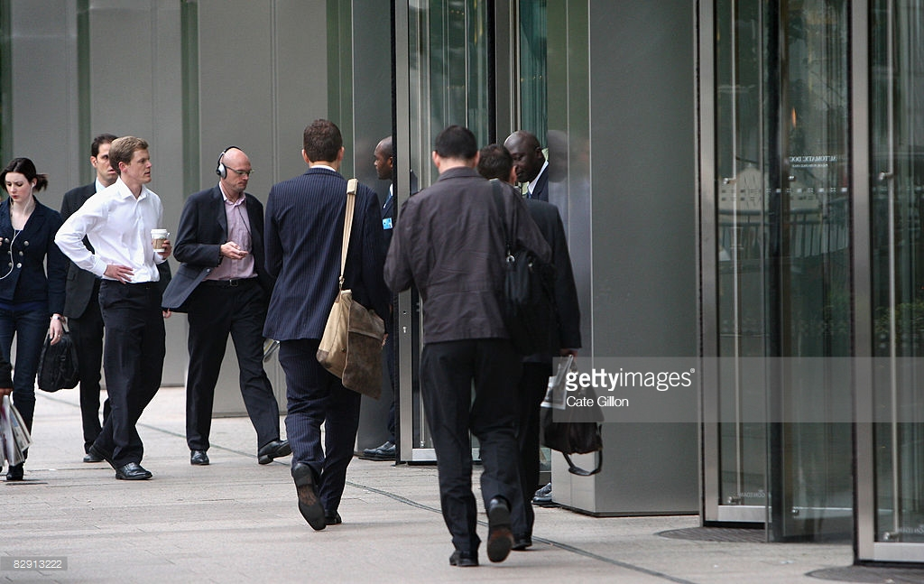

Active Directory
Known users: Accounts created by an admin
What about unknown ones ?

Slide 5
Azure Active Directory Business To Consumer
Azure AD B2C
All the benefits of Active Directory, but users create their own accounts

Slide 6
Azure AD B2C features
Social authentication
Multi Factor Authentication(MFA)
Change user passwords & edit profile
Customize look and feel of pages
Add custom attributes to Active Directory

Slide 7


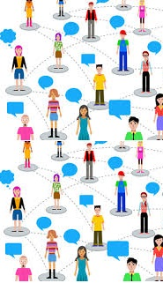
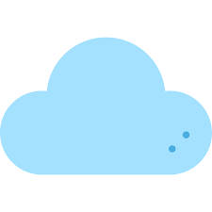

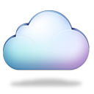

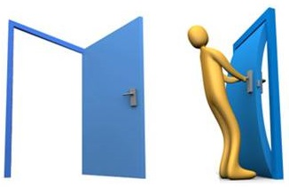


Azure B2C Fundamentals
Tenant
Application
Identity Providers
Users and groups
Policies

Slide 8
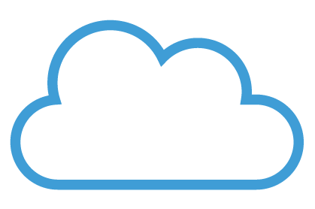
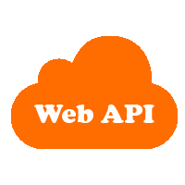
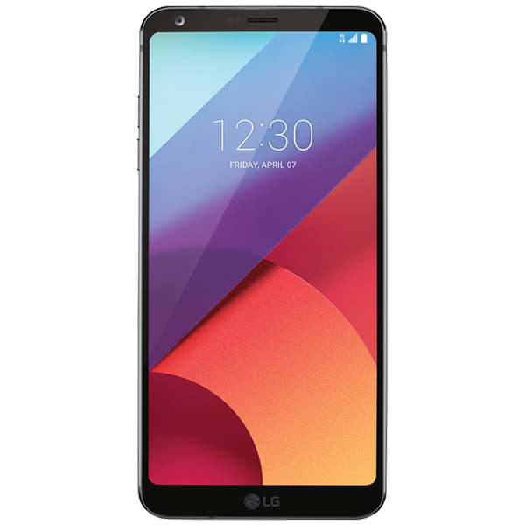
Accessing resources
Azure AD B2C
INVOKE
POLICY
VERIFY
TOKEN
REQUEST
(with TOKEN)
RESPONSE

Slide 9
Quick Review
Cloud - Azure AD B2C
Tenant
Applications
Identity Providers
Users
Policies
Client Side
Mobile app/Web App
Policy
Token
Access Resources

Slide 10
Develop mobile apps…
Configure Azure Portal
Use Microsoft Authentication Library (MSAL)

Slide 11
Thank you
Files : http://github.com/xamarin007
Sam Nanduri
Sr. Mobile Developer Southeastern Grocers
@xamarin007
sam@xamarin007.com

